Slide 1


JobScraper
SPRINT REVIEW · SPRINT 1
AI-assisted job sourcing, straight from company websites.
neuefische bootcamp team · 09.10.2026
Notes:
Welcome. Today we walk through three areas: the data side (what we found and modelled), how we organised ourselves, and the code we have running so far.

Slide 2
What we did this sprint
AGENDA
01
02
03
Data
Organization
Code
Endpoints, ER diagram, proof of concept through case studies
Tickets, templates and conventions on GitHub
Monorepo, frontend on Vercel and backend on Render
Notes:
Three blocks today: Data, Organization, Code.

Slide 3

Our Proof of Concept (in progress)
01 · DATA
STAGE 2
STAGE 3
STAGE 4
STAGE 1
Find companies
Crawl and extract
Pick a parameters
Expand search
Industry or skills from a job seeker
Searches for companies in that field
Add neighbouring companies and competitors
Visit each company website, store jobs as structured data
We asked for company websites. It kept returning aggregators and job platforms instead, the very middlemen we want to avoid.
Notes:
Our proof of concept follows the Hunt and Gather stage of the roadmap: start from the job seeker's field, find companies, widen the net to competitors, then crawl each company's own site and store findings in a structured, timestamped way.

Slide 4


Two data endpoints we found
01 · DATA
Wikidata
Companyenrich
https://query.wikidata.org/
https://api.companyenrich.com/companies
It returns trusted company data
It returns exhaustive company metadata
Notes:
Show both endpoints live if possible. Explain what each one gives us and how it feeds the companies and locations tables.

Slide 5
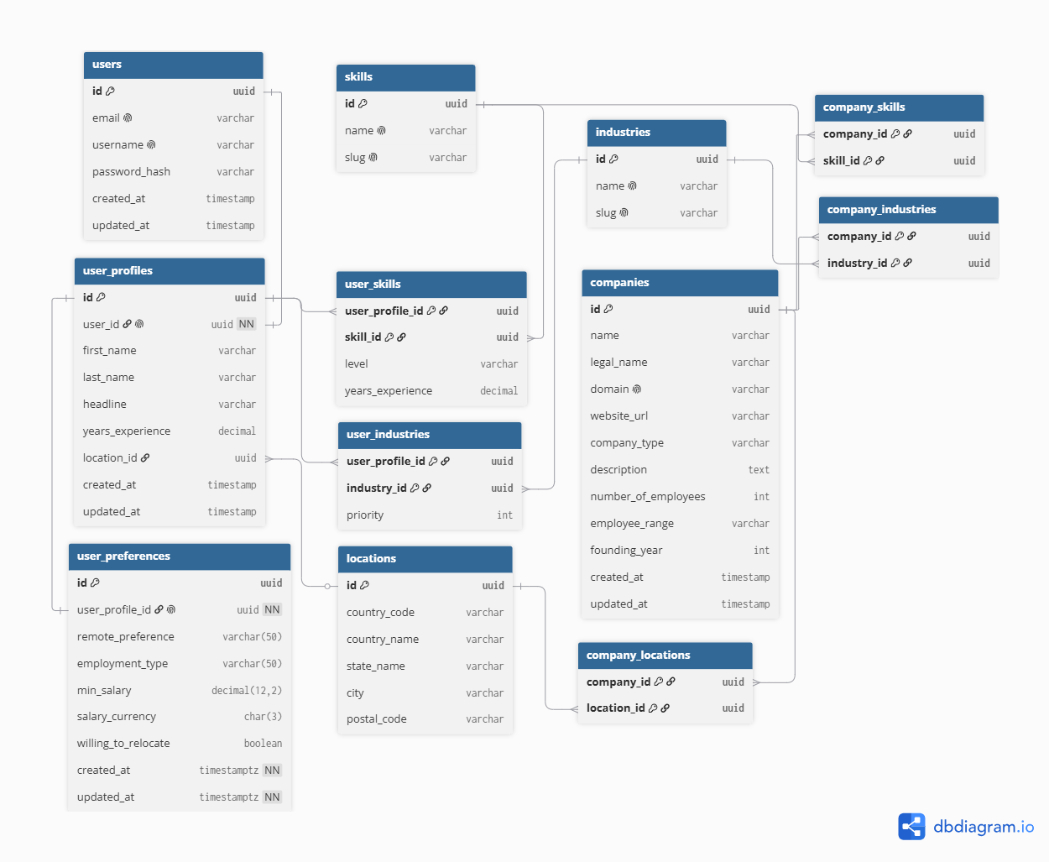
Our data model
01 · DATA
Job seekers
users, profiles and preferences
Shared vocabulary
skills, industries and locations
Companies
linked to the same skills, industries and locations
Notes:
12 tables in three groups. The key idea: job seekers and companies share the same skills, industries and locations tables, so matching becomes a join. user_skills carries level and years of experience; user_industries carries a priority.

Slide 6




How we work together
02 · ORGANIZATION
Tickets
Templates
Conventions
All work tracked as GitHub issues
Issue template, PR template and a release PR template
Conventional Commits, PR titles linted in CI
feature/* · fix/*
develop
main
3 approvals per PR · protected branches
Notes:
Every piece of work starts as a GitHub ticket. Templates keep issues and PRs consistent. Commits follow Conventional Commits and CI lints PR titles. Feature branches merge into develop; develop is released to main via a release PR. Each PR needs three approvals.

Slide 7
One monorepo, fully configured
03 · CODE
job-scraper/
├─ apps/backend NestJS API
├─ apps/frontend Next.js UI
pnpm + Turborepo
One install, one dev command
├─ packages/shared shared code
├─ packages/* tsconfig, eslint
Strict TypeScript
└─ doc/ roadmap, ADRs
Shared lint and format presets
Quality gates
Pre-commit hook, pnpm check, CI
Notes:
pnpm workspaces plus Turborepo. Shared TypeScript, ESLint and Prettier configs live in packages. Architecture decisions are recorded as ADRs in doc/adr. A pre-commit hook formats and lints staged files; pnpm check runs lint, typecheck, test and format.

Slide 8

Two skeleton apps, up and running
03 · CODE
apps/frontend
apps/backend
Next.js
NestJS
https://job-scraper-capstone.vercel.app/
server-to-server calls
https://job-scraper-backend-314v.onrender.com/
Deployed to Vercel
Deployed to Render
Notes:
Frontend is a thin Next.js layer that only calls the backend (ADR-002). It's already deployed to Vercel — show the live URL. Backend is a NestJS skeleton running locally; all business logic, persistence, scraping and auth will live there.

Slide 9
Thank you.
UP NEXT
Next sprint
Advance UI
Finalize Database Schema
Questions?
Finishing proof of concept
Notes:
Close with next sprint goals, then open for questions and feedback.

